Slide 1
TIM 155: Water and Energy Management Energy Supply slides
Professor Brent Haddad
Summer 2016

Slide 2
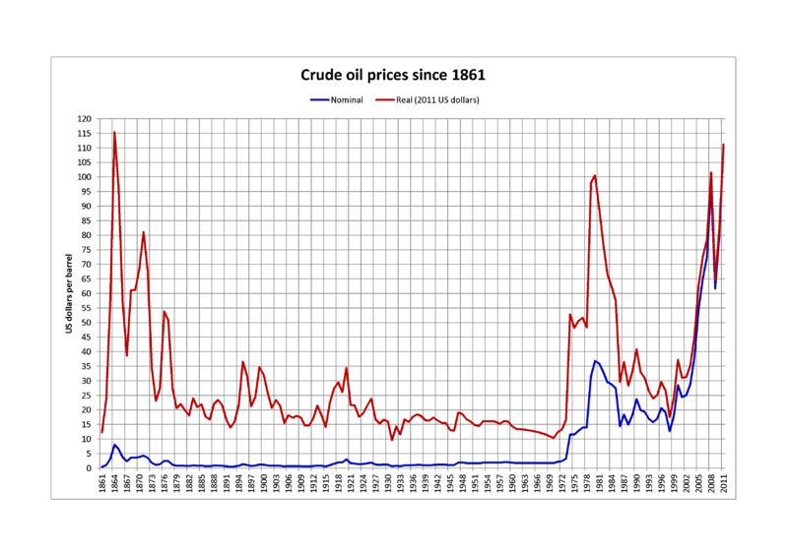
The Price of Oil. Does this define modern, industrial society?
Notes:
http://www.energybulletin.net/node/3338
Turning attention to the price data, we may note first how expensive whale oil was in comparison with the crude oil that replaced it. Even at its lowest historical prices, in the 1820s, the least expensive type of oil (whale oil) was priced at more than $200 (2003$) a barrel (42 gallons). At its highest price level (1855) Sperm Whale oil sold at more than $35 (2003$) a gallon, namely almost $1500 (2003$) a barrel (!). This tells us something about how difficult it may be to substitute fossil fuels with "biofuels" (bio-ethanol, bio-diesel, or other). Without the support of fertilizers, irrigation, transportation, and agricultural machinery, which all depend on fossil fuels, biofuels would probably cost as much today as whale oil did in the 19th Century. It also shows what an incredible bonanza crude oil has been. When kerosene became first available in the 1860s, a barrel of crude oil sold for some $90 a barrel in to-day's money (data from www.wtrg.com). In the 1870-80s it had already fallen to values in the order of $20 (2003$) a barrel, comparable with modern prices. If hydrogen were to substitute gasoline today at the same price differential, it would have to cost no more than a few cents for the equivalent of a gallon. Needless to say, we aren't getting there any time soon.

Slide 3
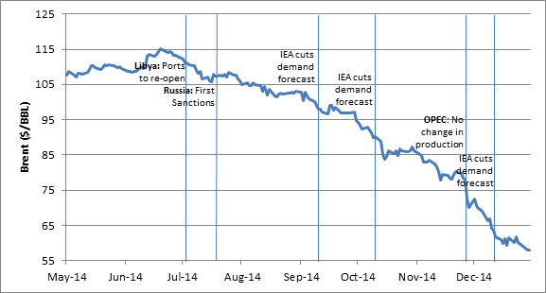
The Economic Oil Wars

Slide 4
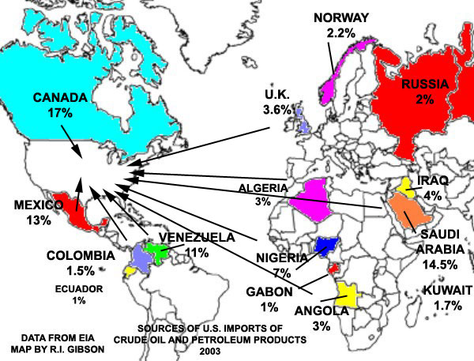
U. S. Oil Imports

Slide 5
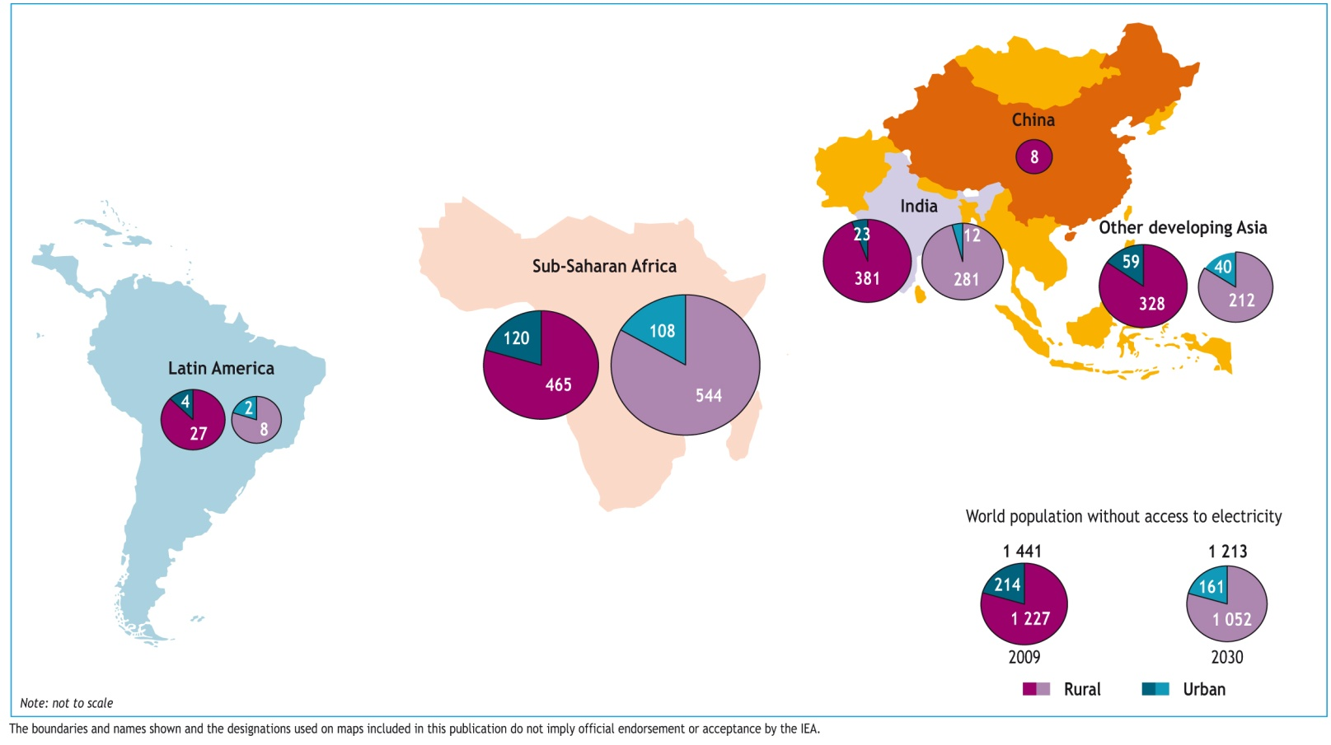
Energy Poverty:
Forecasts of Little Improvement
There are 1.4 billion people lacking access to electricity today
Based on current trends, 1.2 billion people will still lack access in 2030
Another 1+ billion have intermittent/unreliable access
International Energy Agency, 2010
UN General Assembly resolution 65/151

Slide 6
Getting Comfortable with Energy Units
1 joule is a unit of energy (1 J/second = 1 Watt)
1 barrel (bbl) of crude oil = 42 gallons = 6.12 x 10⁹ joules
1 MToe = million tons of oil, equivalent = 10¹³ joules
A useful unit calculator: http://www.iea.org/statistics/resources/unitconverter/
1 Quad = 1 quadrillion Btu = ~ 1 Exajoule (10¹⁸ Joules)
Questions: How many barrels of crude oil is 1 Mtoe?
How many barrels is 1 Exajoule (10¹⁸ Joules)?
Notes:
Answers: 1633 barrels, 163 million barrels

Slide 7
Energy Orders of Magnitude (EJ = Exajoule = 10¹⁸ J)
5,500,000 EJ Annual solar influx
1,000,000 EJ Fossil occurrences
50,000 EJ Fossil reserves
440 EJ World energy use 2000 (14 TW)
100 EJ USA primary energy supply
50 EJ OECD transport energy use
20 EJ Saudi Arabia oil production
4 EJ Italy oil reserves
1 EJ NY city or Singapore energy use
Stocks; flows (yr⁻¹)

Slide 8
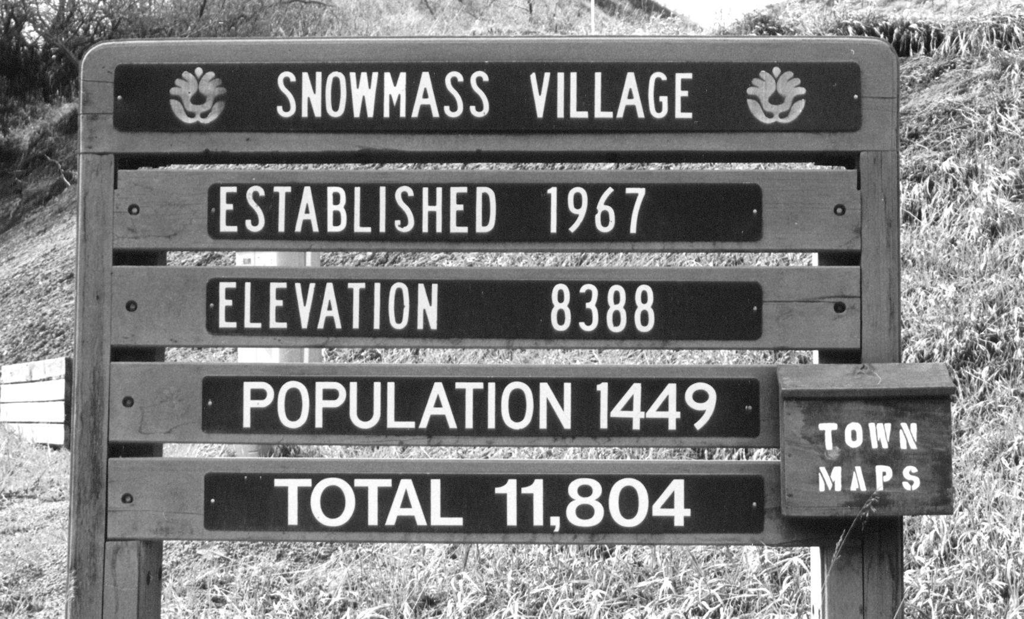
To make sense of the world, make consistent comparisons

Slide 9
Check the Units, carbon emissions are often expressed at gC/MJ, and at present Global emissions are 16 gC/MJ, and global energy use is 470 EJ so:
Notes:
Fig. 4.16: Carbon intensity of world primary energy mix, 1850 to 1990, in tC per toe, inclunding emissions from unsustainable uses of fuelwood.

Slide 10
US energy use/$ GDP already cut 40%, to very nearly the 1976 “Soft Energy Pat1976h”
Amory Lovins’ Soft Energy Path: 1976
Notes:
One quadrillion BTUs, or 1 Quad.
1 Quad = 10¹⁵ BTU
1 BTU = 1055.06 joules
1 Quad ≈ 1.05 ExaJoule (10¹⁸ joules)
Therm = 10⁵ BTU

Slide 11
U.S. Efficiency Improvements
Savings >$170 billion annually, since 1990
GDP
Indexed
(1950=100)
Energy
Carbon
37% improvement
Source: EIA, BEA, PCAST

Slide 12
Two Views
Pessimists (“Mathusian” or “Cassandra”)
Developed economies unsustainable; developing cannot follow in their path; technology is not keeping pace with resource depletion, environmental impact
Optimists (“Cornucopian” or “Dr. Pangloss”)
No barriers to growth; substitutes will be developed for scarce resources; economic development and technology produce net improvement in environmental quality

